Slide 1
Chapter - 1
Basics of Financial Accounting
Video number 1-11 are mandatory part of this module
MGT 101
Financial Accounting
By
Mian Ahmad Farhan, FCA

Slide 2
Contents
Sr. No | Course Outline – Topics
1 | Definition of Accounting & Financial Information
2 | Sources of Financial Information
3 | Money Measurement & Financial Position
4 | Functions of Financial Accounting
5 | Elements of Financial Statements
6 | Entity and Separate Entity Concept
7 | User of Financial Information
8 | Underlying Assumption – Going Concern
9 | Recognition of the elements of financial statements
10 | Measurement of the elements of financial statements
11 | Qualitative characteristics of useful financial information

Slide 3

Basics of Financial Accounting
Definition of Accounting and Financial Information
Notes:
Before we proceed, I want my audience to brain storm, whether accounting is a

Slide 4

Accounting
Is accounting:
process
activity
system
subject
Source of images: Google

Slide 5

Accounting is a Language
Language is a medium that is used to
communicate
understand
some
ideas
policies
plans
information
Source of images: Google

Slide 6

Definition of Accounting
Accounting is a language that is used to
communicate and
understand
the
financial ideas
financial policies
financial plans
financial information
Source of images: Google

Slide 7


Branches of Accounting
Financial Accounting
financial information
Management Accounting
financial ideas
financial policies
financial plans
Source of images: Google

Slide 8


Financial information
An information that is
measurable in terms of money, and
causing a change in financial position
of an entity
Source of images: Google

Slide 9
Important Tips To Remember - ITTR
Accounting is a language
Financial information is measurable in terms of money and belongs to the past

Slide 10
Sources of Financial Information
Basics of Financial Accounting

Slide 11
Sources of Financial Information
There are three sources of financial information
Transactions
Events
Conditions
also known as accounting phenomena

Slide 12



Transaction
Transaction occurs when two persons deal with each other.
Social motives dealings
Social transaction
birthday gift etc.
Economic benefits dealing Accounting transaction
monetary dealing between the entity and other person
Source of images: Google

Slide 13



Accounting Transaction
Dealing between entity and other persons:
entity with owner/s
entity with any person other than the owner/s
There are two criteria to identify an accounting transaction:
Measurability in terms of money
Dealing of the entity with other person
Source of images: Google

Slide 14
Practice 1.1
Keeping in view the criteria, identify which of the following information is accounting transaction:
Payment of staff salaries made by cheque.
Appointing a production manager on contract.
Having a conversation with foreign supplier for import of raw material.
Placing an order for purchase of production machine.
Purchasing motor vehicle and paying cash for the price.

Slide 15
Practice 1.2
Identify accounting transactions:
Up-keeping expenses of building paid by cheque.
Collection of dues from customers.
Negotiating with bank for taking loan.
Receiving cash against loan from bank.
Payment of personal expenses of the owner in cash.

Slide 16
Event
Event means anything that happens. There are two types of events:
Monetary
Non-Monetary
Monetary Event
Examples include:
Loss by fire
Loss by accident
Foreign exchange (gain/loss)
Non-Monetary Event
Examples include:
Winning or losing a game that does not carry financial impacts

Slide 17

Condition
Condition covers certain adjustments in already recorded transactions and events.
Examples include:
Provision to be created against expected doubtful recovery from customer
Fixed Assets to be depreciated according to their expected useful life
Source of images: Google

Slide 18
Practice 1.3
Which of the the following information is Transaction, Event or Condition:
Stock in godown lost by fire
Giving away gifts to employees of the entity
Training to employees through external trainers
Organizing a dinner for entity’s valued customers
Recognizing depreciation of machinery
Insurance claim recovered from insurance company against stock lost by fire
Cash paid as charity to a hospital
Answer:
Event
Transaction
Transaction
Transaction
Condition
Transaction
Transaction

Slide 19
Important Tips To Remember - ITTR
Three sources of financial information
Transaction results from a deal
First party is the entity itself dealing with others
Each accounting information is measurable in money

Slide 20
Money Measurement and Financial Position
Basics of Financial Accounting

Slide 21

Money measurement
Money measurement means to assign a value in reporting currency to an accounting phenomena.
Source of images: Google

Slide 22



Measurement parameters
Measuring its weight 10.0 Kg
Measuring its length 3.0 Feet
Measuring its width 1.5 Feet
Measuring its height 2.0 Feet
Rs. 15,000 its money measurement in reporting currency.
Source of images: Google

Slide 23
Practice 1.4
Which of the following information is carrying money measurement?
Bought 30 numbers of computers.
Bought 10 fans @ Rs. 1,500 each, cash paid immediately.
Scrap dumped, weighted 150 Kg.
5 workers are working on plant in double shift.
Bought raw material worth Rs. 50,000, cash is not yet paid.
No
Yes
No
No
Yes

Slide 24
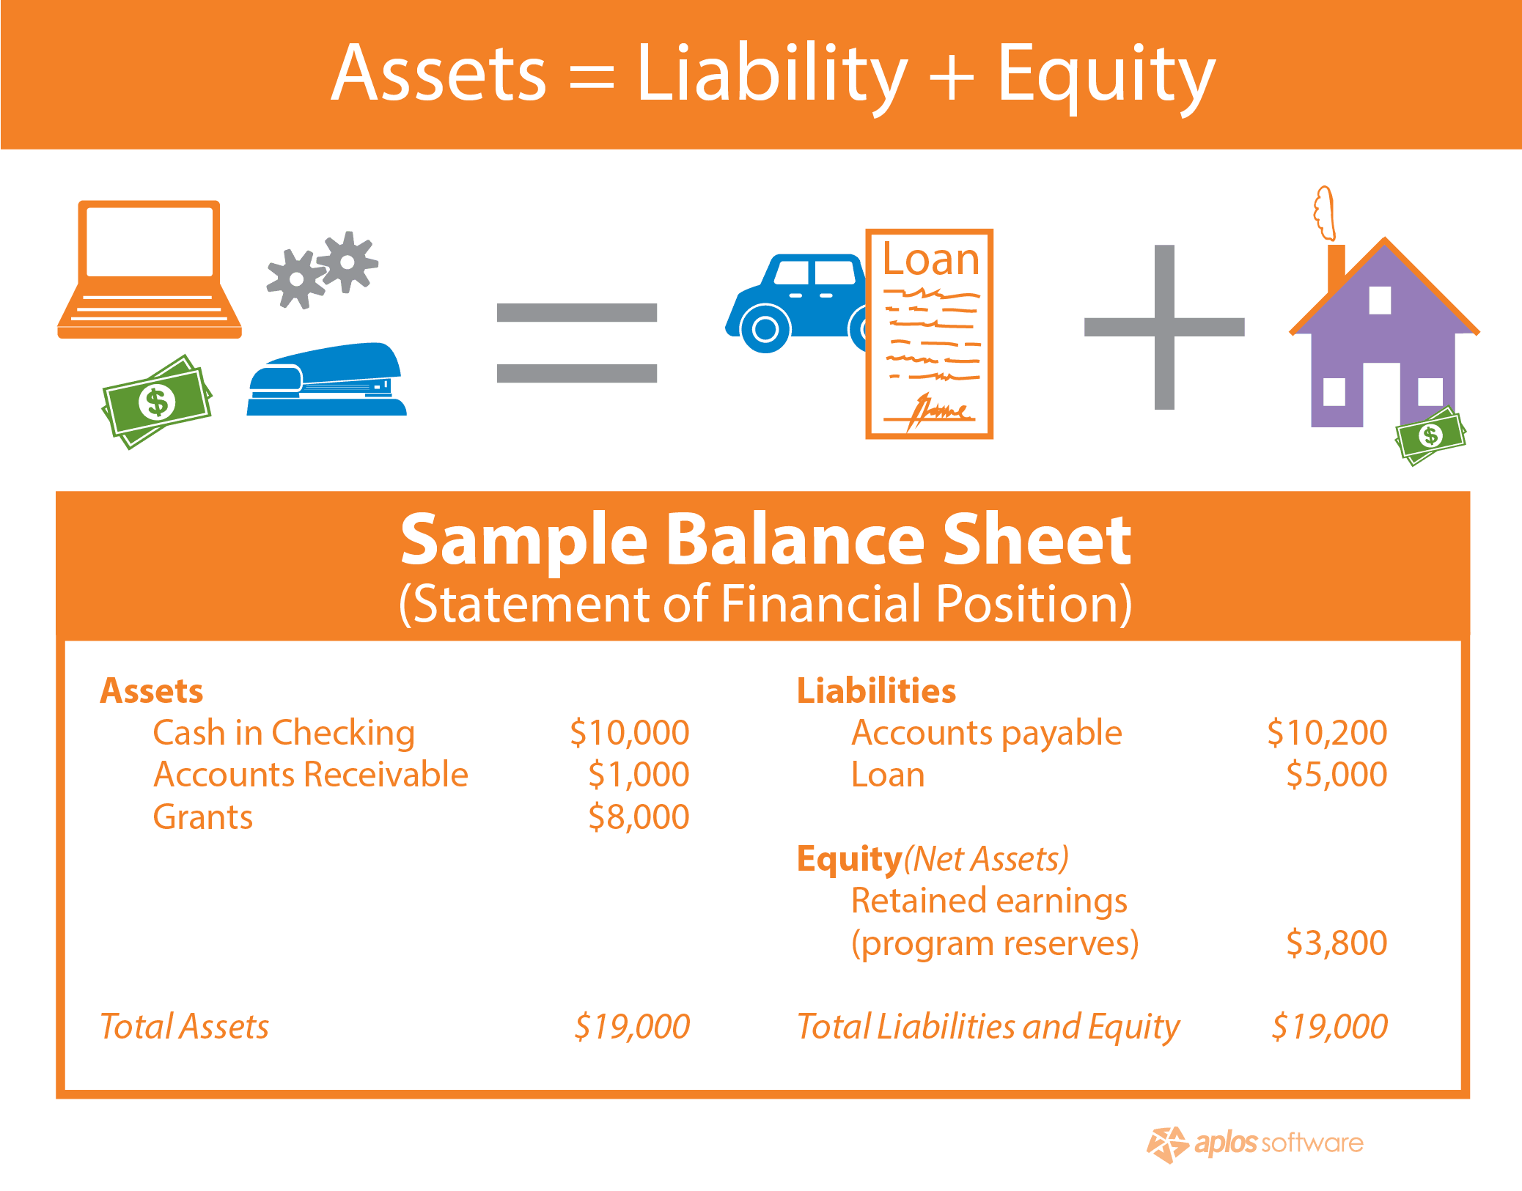
Financial position
Financial position means; an entity’s status of Resources & Sources.
Resources are the assets
Sources are the means of finances that include liability and owners’ equity
ASSETS Rs. LIABILITIES Rs.
Furniture 80,000 Bank loan 35,000
Computers 10,000 Other payable 15,000
EQUITY
Owner’s Capital 40,000
TOTAL 90,000 TOTAL 90,000
Source of images: Google

Slide 25
Important Tips To Remember - ITTR
Measurement in reporting currency
Financial position means financial status
Resources are equal to sources

Slide 26
Functions of Financial Accounting
Basics of Financial Accounting

Slide 27
Functions of financial accounting
Financial accounting is required to:
Classify
Record
Summarize
Report
Analyze
These are the five functions of Financial Accounting that are covered in
Accounting Cycle

Slide 28
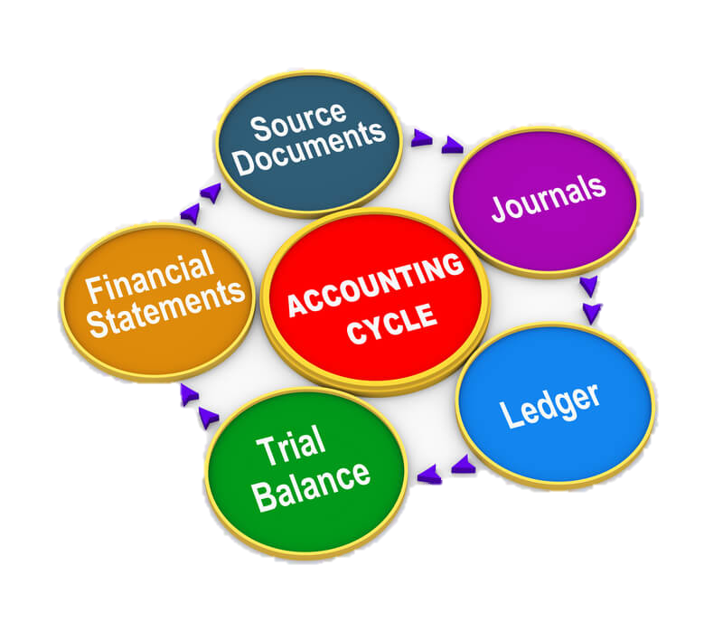
Accounting cycle
Source of images: Google

Slide 29
Important Tips To Remember - ITTR
Financial accounting is about past information
Accounting Cycle starts from source documents and ends at analysis of past information

Slide 30
Elements of Financial Statements
Basics of Financial Accounting

Slide 31
Classifying financial information
Financial information are classified into five main heads, these are also known as elements of financial statements

Slide 32
Elements of financial statements
Elements of Financial Statements
Assets
Equity
Income
Expense
Liabilities

Slide 33
Elements of financial statements
Assets:
Assets are the resources in control
Liabilities:
Liabilities are the present obligations
Owners’ Equity:
Owners’ equity is the source of finance that represents owners' stake
Incomes:
Incomes are earnings
Expenses:
Expenses are the costs that expire

Slide 34
Sub-classification of Main Heads
Main Heads | Assets | Liabilities | Owners’ Equity | Incomes | Expenses
Accounting Heads | Land | Bank loan | Capital | Sales | Purchases
 | Building | Bank overdraft | Drawings | Service Fee | Salaries
 | Machinery | Creditors | Profits | Commission | Electricity
 | Furniture | Payable | etc. | etc. | Repair
 | Motor Van | etc. |  |  | Advertisement
 | Computer |  |  |  | Telephone
 | Stocks |  |  |  | Traveling
 | Receivables |  |  |  | Freight
 | Cash Balance |  |  |  | Rent
 | Bank Balance |  |  |  | Stationery
 | etc. |  |  |  | etc.

Slide 35
Important Tips To Remember - ITTR
There are five main heads
Assets are resources in control of entity
Liabilities are present obligation
Present obligation means – obligation at the end of reporting period
Accounting heads are sub-heads

Slide 36
Entity and
Separate Entity Concept
Basics of Financial Accounting

Slide 37
Entity
Purpose of an entity
Profit motive
Welfare Society
Non profit motive
Business
Financial information is involved in both profit motive and non-profit motive entities.
Therefore, financial accounting is a need for a business as well as a welfare society.

Slide 38

Separate Entity Concept
A business entity and its owner are two different persons.
For accounting purposes, business has separate entity/identity apart from its owner.
Source of images: Google

Slide 39
Practice 1.5
Based on the business entity concept, which of the following information would be accounted for in the accounting books of an entity/business?
Cash invested as capital of the business by the owner.
Owner bought motor car for his personal use out of his personal bank account.
Owner used a part of his residential building for the business godown for which he was paid rent out of business bank account.
Owner took loan for his daughters’ marriage from a friend.
Goods bought by business for trading were consumed by the owner for his personal consumption.
Answers (1, 3, 5)

Slide 40
Important Tips To Remember - ITTR
Accounting is a requirement of each entity
Business has separate entity apart from its owner
Accounting entity concept is different from the legal entity concept

Slide 41
Users of Financial Information
Basics of Financial Accounting

Slide 42
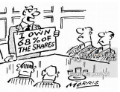


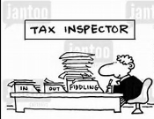
Users of Financial Information
Investor/Shareholders/owners How well the management is performing
Trade contacts Suppliers and customers
Lenders providers of finance are lenders
Taxation authorities assess the tax payable by the entity, including sales taxes etc.
Source of images: Google

Slide 43
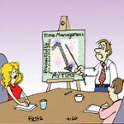
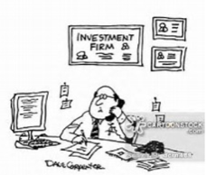


Users of Financial Information
Manager and Employees To enable them to manage the business
Financial consultants and advisers For their clients
Government Interested in the allocation of resources
Public Entity may make a substantial contribution to a local economy
Source of images: Google

Slide 44
Practice 1.6
Which of the following statements is true or false:
Debt burden of the company is the information mostly required by income tax authorities.
Dividend declaration is the information needed by shareholders.
Financial ratios are most likely required by financial consultants
Bonus to employees is the information that is needed by Government
Cost of sales information is usable for managers.
Welfare society is always interested in green policies cost of company.
Answers: (1-false 2-true 3-true 4-False 5-true 6-True)
False
True
True
False
True
True

Slide 45
Important Tips To Remember - ITTR
Financial accounting produces general purpose financial statements
Users are internal and external

Slide 46
Underlying Assumption
Going Concern
Basics of Financial Accounting

Slide 47
Underlying Assumption
Going Concern
Assumption that a business entity will remain in existence for the foreseeable future

Slide 48
Going concern
Examples include:
Significant trading losses being incurred for several years
Deteriorating liquidity position
High financial risk arising from increased debts level
Aggressive growth strategy not backed by sufficient finance
Serious litigations
Inability of a company to develop a new range of commercially successful products.
Bankruptcy of major customer

Slide 49
Important Tips To Remember - ITTR
Accounting principles cannot be applied if entity is not a going concern
Reporting requirements would be different if entity is not a going concern

Slide 50
Recognition of the elements of financial statements
Basics of Financial Accounting

Slide 51
Recognition of Financial Information
Recognition Criteria
probable future economic benefit will flow to or from the entity; and
cost or value can be measured with reliability

Slide 52
Recognition Criteria
Asset
  probable inflow of future economic benefits, and
  cost or value can be measured reliably.
Liability
  probable outflow of resources embodying economic benefits will result from the settlement of a present obligation and
  amount at which the settlement will take place can be measured reliably.

Slide 53
Recognition Criteria
Income
  an increase in future economic benefits related to an increase in an asset or a decrease of a liability has arisen, and
  amount can be measured reliably.
Expense
  a decrease in future economic benefits related to a decrease in an asset or an increase of a liability has arisen, and
  amount can be measured reliably.

Slide 54
Important Tips To Remember - ITTR
Recognition means to identify correct main head
Recognition is done at classifying stage in accounting cycle

Slide 55
Measurement of the elements of financial statements
Basics of Financial Accounting

Slide 56
Measurement of Financial Information
Measurement Bases
Historical
Cost
Current
Cost
Realizable (Settlement) Value
Present
Value

Slide 57
Measurement Bases
Historical cost
Current cost
Net realisable (settlement) value
Present value (discounted cash flows)
Historical cost is the most commonly used measurement basis, it is usually combined with other measurement bases.

Slide 58
Important Tips To Remember - ITTR
Initial measurement is done at recognition
Subsequent measurement is needful at the end of reporting period and in certain cases at the time of de-recognition

Slide 59
Qualitative characteristics of useful financial information
Basics of Financial Accounting

Slide 60
Qualitative characteristics
Fundamental
Relevance
Faithful representation
Enhancing
Comparative
Verifiability
Timeliness
Understandability
Materiality
Cost constraint on useful financial reporting
Notes:
Page 13/32 of Original FW
Willey
The fundamental characteristics are applied by following a three-step process.
Firstly, identify the economic phenomenon that has a potential to be useful.
Secondly, identify the type of information regarding the phenomenon that is most relevant that could be faithfully represented.
Finally, determine whether that relevant information is available and could be faithfully represented.
After that the enhancing characteristics are applied to confirm or enhance the quality of the information.

Slide 61
Fundamental Qualitative Characteristics
Relevance
Confirmatory Value
Predictive Value; or
Faithful representation
Complete
Neutral
Free from error
Both
Materiality is an entity specific aspect of Relevance based on:
Nature
Magnitude; or
Both
Notes:
Pare 13, 14, 15/32

Slide 62
Enhancing Qualitative Characteristics
Comparability
Consistency
Verifiability
Direct
Indirect
Timeliness
Understandability
Timely Report
Reliable Information
Reasonable Knowledge
Disclosures
Notes:
Page 16,17/32

Slide 63
Important Tips To Remember - ITTR
Qualitative financial information produce qualitative financial statements
Information is material if its non-disclosure changes the decision of the user of financial statement

Slide 64

Thank you very much
for being attentive

