Slide 1
Elect. Codebook, Cipher Block Chaining
Network Security

Slide 2
Elect. Codebook, Cipher Block Chaining
Objectives of the Topic
After completing this topic, a student will be able to
describe electronic codebook and cipher block modes.

Slide 3
Elect. Codebook, Cipher Block Chaining
Figures and material in this topic have been
adapted from “Network Security Essentials: Applications and Standards”, 2014, by William Stallings.

Slide 4
Elect. Codebook, Cipher Block Chaining
A symmetric block cipher processes one block of data at a time.
Block length is 64 bits for DES and 3DES
For AES, the block length is 128 bits.

Slide 5
Elect. Codebook, Cipher Block Chaining
If the amount of plaintext is greater than b-bits, then we can break the plaintext up into b-bit blocks.
When multiple blocks of plaintext are encrypted using the same key, a number of security issues arise.

Slide 6
Elect. Codebook, Cipher Block Chaining
Five modes of operation have been defined by NIST (SP(Special Publication) 800- 38A) so that a block cipher can be applied in a variety of applications.

Slide 7
Elect. Codebook, Cipher Block Chaining
A mode of operation is a technique for enhancing the effect of a cryptographic algorithm or adapting the algorithm for an application, such as applying a block cipher to a sequence of data blocks or a data stream.

Slide 8
Elect. Codebook, Cipher Block Chaining
Electronic Codebook Mode (ECB)
Cipher Block Chaining Mode (CBC)
Cipher Feedback Mode (CFB)
Output Feedback (OFB)
Counter Mode (CTR)

Slide 9
Elect. Codebook, Cipher Block Chaining
Electronic Codebook Mode:
Simplest mode
Plaintext is handled b bits at a time and each block of plaintext is encrypted using the same key.

Slide 10
Elect. Codebook, Cipher Block Chaining
The term codebook is used because, for a given key, there is a unique ciphertext for every b-bit block of plaintext.

Slide 11
Elect. Codebook, Cipher Block Chaining
We can imagine a gigantic codebook in which there is an entry for every possible b-bit plaintext pattern showing its corresponding ciphertext.

Slide 12
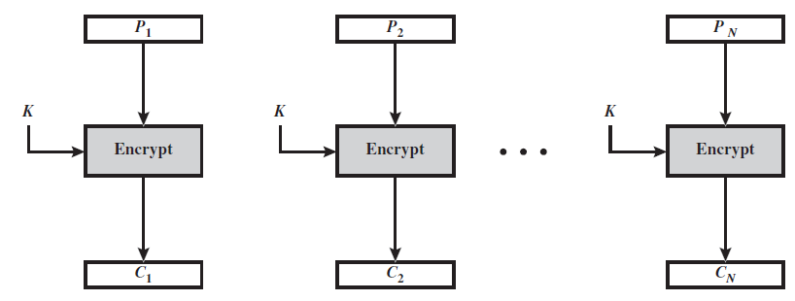
Elect. Codebook, Cipher Block Chaining
For a message longer than b bits, the procedure is simply to break the message
into b-bit blocks

Slide 13
Elect. Codebook, Cipher Block Chaining
With ECB, if the same b-bit block of plaintext appears more than once in the message, it always produces the same ciphertext.
Because of this, for lengthy messages, the ECB mode may not be secure.

Slide 14
Elect. Codebook, Cipher Block Chaining
If the message has repetitive elements with a period of repetition a multiple of b-bits, these elements can be identified.
We want to produce different ciphertext blocks for the same plaintext block if repeated .

Slide 15
Elect. Codebook, Cipher Block Chaining
Cipher Block Chaining Mode:
The input to the encryption algorithm is the XOR of the current plaintext block and the preceding ciphertext block.
The same key is used for each block.

Slide 16
Elect. Codebook, Cipher Block Chaining
In effect, we have chained together the processing of the sequence of plaintext blocks.

Slide 17
Elect. Codebook, Cipher Block Chaining
The input to the encryption function for each plaintext block bears no fixed relationship to the plaintext block.
Therefore, repeating patterns of b-bits are not exposed.

Slide 18
Elect. Codebook, Cipher Block Chaining
CBC Encryption:
To produce the first block of ciphertext, an initialization vector (IV) is XORed with the first block of plaintext.
For the jth output

Slide 19
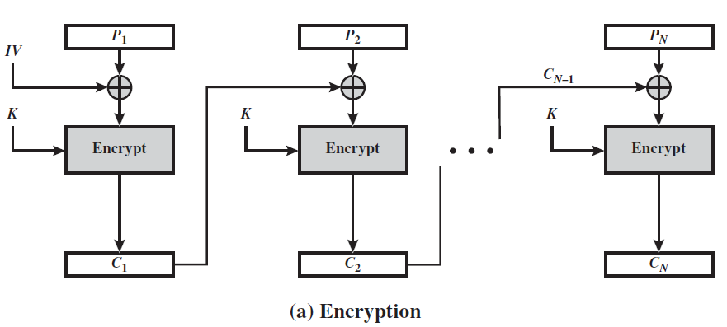
Elect. Codebook, Cipher Block Chaining

Slide 20
Elect. Codebook, Cipher Block Chaining
The IV must be known to both the sender and receiver but be unpredictable by a third party.

Slide 21
Elect. Codebook, Cipher Block Chaining
CBC Decryption:
For decryption, each cipher block is passed through the decryption algorithm.
The result is XORed with the preceding ciphertext block to produce the plaintext block.

Slide 22
Elect. Codebook, Cipher Block Chaining
On decryption, the IV is XORed with the output of the decryption algorithm to recover the first block of plaintext.

Slide 23
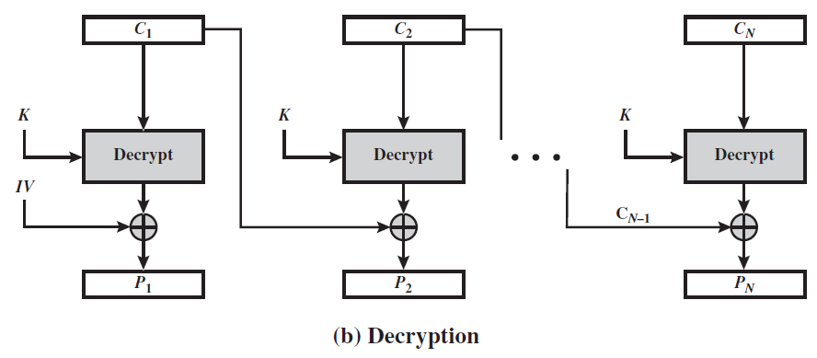
Elect. Codebook, Cipher Block Chaining

Slide 24
Elect. Codebook, Cipher Block Chaining
Because of the chaining mechanism of CBC, it is an appropriate mode for encrypting messages of length greater than b-bits.
End

