Slide 1
Definition Of Computer Security
Network Security

Slide 2
Definition Of Computer Security
Objectives of the Topic
After completing this topic, a student will be able to
describe a definition of the computer security.

Slide 3
Definition Of Computer Security
Figures and material in this topic have been
adapted from “Network Security Essentials: Applications and Standards”, 2014, by William Stallings.

Slide 4
Definition Of Computer Security
The National Institute of Standards and Technology (NIST) Computer Security Handbook defines the term computer security as follows:

Slide 5
Definition Of Computer Security
The protection afforded to an automated information system in order to attain the applicable objectives of preserving the integrity, availability, and confidentiality of information system resources.

Slide 6
Definition Of Computer Security
Resources include hardware, software, firmware, information/data, and telecommunications.

Slide 7
Definition Of Computer Security
Computer Security: Three Key Objectives
Confidentiality
Integrity
Availability

Slide 8
Definition Of Computer Security
Confidentiality
a) Data confidentiality: Assures that private or confidential information is not made available or disclosed to unauthorized individuals.

Slide 9
Definition Of Computer Security
Confidentiality
b) Privacy: Assures that individuals control or influence what information related to them may be collected and stored and by whom and to whom that information may be disclosed.

Slide 10
Definition Of Computer Security
Integrity
a) Data integrity: Assures that information and programs are changed only in a specified and authorized manner.

Slide 11
Definition Of Computer Security
Integrity
b) System integrity: Assures that a system performs its intended function in an unimpaired manner, free from deliberate or inadvertent unauthorized manipulation of the system.

Slide 12
Definition Of Computer Security
Availability
Assures that systems work promptly and service is not denied to authorized users.

Slide 13
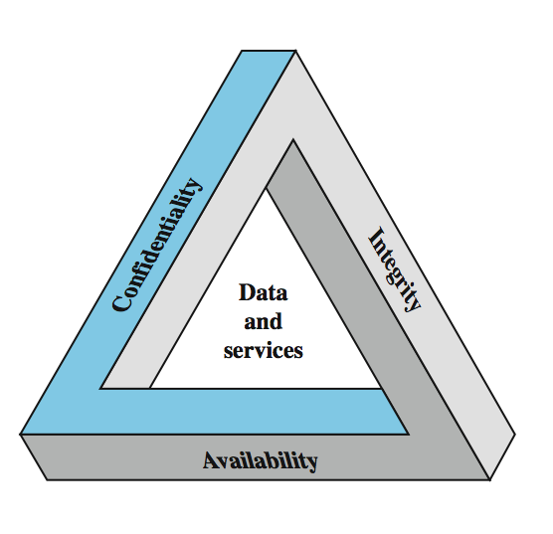
Definition Of Computer Security
The Security Requirements
Triad:
CIA Triad

Slide 14
Definition Of Computer Security
Possible Additional Concepts:
Authenticity
Accountability

Slide 15
Definition Of Computer Security
Authenticity:
The property of being genuine and being able to be verified and trusted.
verifying that users are who they say they are and that each input arriving at the system came from a trusted source.

Slide 16
Definition Of Computer Security
Accountability:
The security goal that generates the requirement for actions of an entity to be traced uniquely to that entity.
This supports nonrepudiation, intrusion detection and prevention etc.

Slide 17
Definition Of Computer Security
Accountability:
Systems must keep records of their activities to permit later forensic analysis to trace security breaches or to aid in transaction disputes.
End

