Slide 1
Key Exchange, Man-in-the-Middle Attack
Network Security

Slide 2
Key Exchange, Man-in-the-Middle Attack
Objectives of the Topic
After completing this topic, a student will be able to
describe Man-in-the-Middle Attack while performing key exchange.

Slide 3
Key Exchange, Man-in-the-Middle Attack
Figures and material in this topic have been adapted from
“Network Security Essentials : Applications and Standards”, 2014, by William Stallings.

Slide 4
Key Exchange, Man-in-the-Middle Attack
Key Exchange Protocol: An Example
Suppose that user A wishes to set up a connection with user B and use a secret key to encrypt messages on that connection.

Slide 5
Key Exchange, Man-in-the-Middle Attack
User A can generate a one-time private key X_{A}, calculate public value Y_{A}, and send that to user B.
User B responds by generating a private value X_{B}, calculating Y_{B}, and sending Y_{B} to user A.

Slide 6
Key Exchange, Man-in-the-Middle Attack
Both users can now calculate the key.
The necessary public values q and α would need to be known ahead of time.

Slide 7
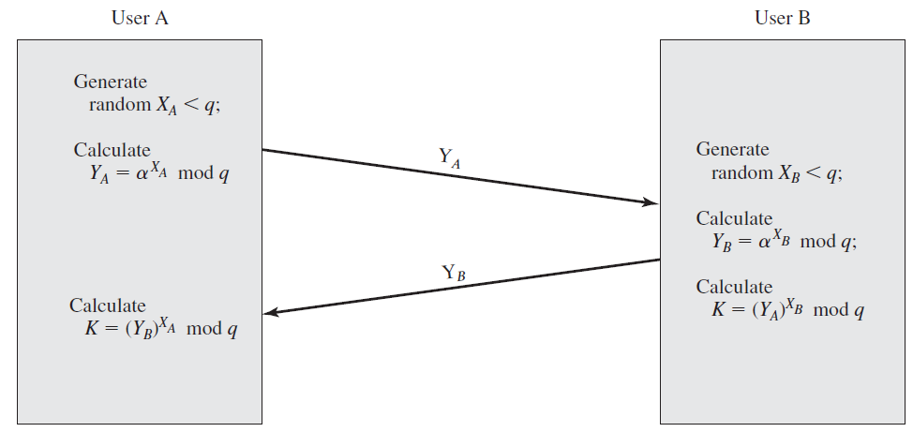
Key Exchange, Man-in-the-Middle Attack

Slide 8
Key Exchange, Man-in-the-Middle Attack
Key Exchange Protocol: Another Example
Suppose that a group of users (e.g., all users on a LAN) each generate a long-lasting private value X_{i} (for user i) and calculate a public value Y_{i}.

Slide 9
Key Exchange, Man-in-the-Middle Attack
These public values, together with global public values for q and α, are stored in some central directory.

Slide 10
Key Exchange, Man-in-the-Middle Attack
At any time, user j can access user i’s public value, calculate a secret key, and use that to send an encrypted message to user i.

Slide 11
Key Exchange, Man-in-the-Middle Attack
If the central directory is trusted, then this form of communication provides both confidentiality and a degree of authentication.

Slide 12
Key Exchange, Man-in-the-Middle Attack
However, the technique does not protect against replay attacks.

Slide 13
Key Exchange, Man-in-the-Middle Attack
Man-in-the-Middle Attack
Suppose Alice and Bob wish to exchange keys, and Darth is the adversary.
The man-in-the-middle attack proceeds as follows

Slide 14
Key Exchange, Man-in-the-Middle Attack
1. Darth prepares for the attack by generating two random private keys X_{D1} and X_{D2} and then computing the corresponding public keys Y_{D1} and Y_{D2}.

Slide 15
Key Exchange, Man-in-the-Middle Attack
2. Alice transmits Y_{A} to Bob.
3. Darth intercepts Y_{A} and transmits Y_{D1} to Bob. Darth also calculates K₂ = (Y_{A})X_{D2} mod q.

Slide 16
Key Exchange, Man-in-the-Middle Attack
4. Bob receives Y_{D1} and calculates K₁ = (Y_{D1})X_{B} mod q.
5. Bob transmits Y_{B} to Alice.
6. Darth intercepts Y_{B} and transmits Y_{D2} to Alice. Darth calculates K₁ = (Y_{B})X_{D1} mod q.

Slide 17
Key Exchange, Man-in-the-Middle Attack
7. Alice receives Y_{D2} and calculates K₂ = (Y_{D2})X_{A} mod q.

Slide 18
Key Exchange, Man-in-the-Middle Attack
At this point, Bob and Alice think that they share a secret key, but instead Bob and Darth share secret key K1 and Alice and Darth share secret key K2.
All future communication bet. Bob and Alice works in following way.

Slide 19
Key Exchange, Man-in-the-Middle Attack
1. Alice sends an encrypted message M: E(K2, M).
2. Darth intercepts the encrypted message and decrypts it to recover M.
3. Darth sends Bob E(K1, M) or E(K1, M′), where M′ is any message.

Slide 20
Key Exchange, Man-in-the-Middle Attack
In the first case, Darth simply wants to eavesdrop on the communication without altering it. In the second case, Darth wants to modify the message going to Bob.

Slide 21
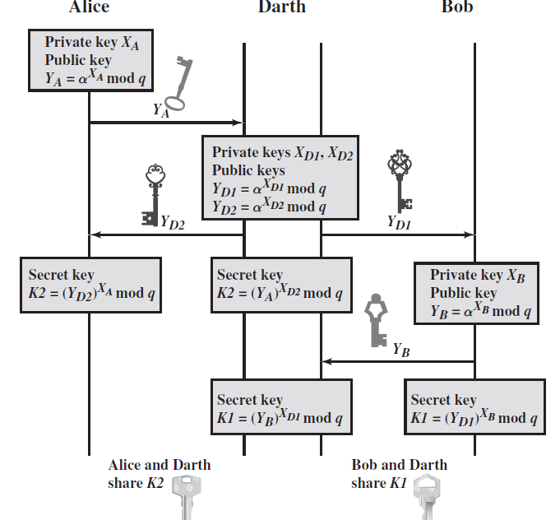
Key Exchange, Man-in-the-Middle Attack

Slide 22
Key Exchange, Man-in-the-Middle Attack
The key exchange protocol is vulnerable to such an attack because it does not authenticate the participants.
End

