Slide 1
Applied Biostatistics
Topic 1

Slide 2
Applied Biostatistics
Introduction to Biostatistics

Slide 3
Introduction to Biostatistics
Statistics is a field of study that is concerned with:
The collection, organization, summarization, and analysis of data.
The drawing of inferences about a body of data, when only a part of data is observed.

Slide 4
Introduction to Biostatistics
Statistics also plays a vital role in all the phases of research starting from the planning to the policy making.

Slide 5
Introduction to Biostatistics
BioStatistics is
The use of statistical tools for the data that is derived from biological sciences and medicine.
Bio-statistical methods were used in the ancient civilizations like Ancient Greece, Ancient Rome, India and China.

Slide 6
Introduction to Biostatistics
One of the earliest known demographic / Bio-statistics study was conducted by John Graunt (1662). He developed life tables to warn off the onset and spread of Bubonic plague in London.

Slide 7
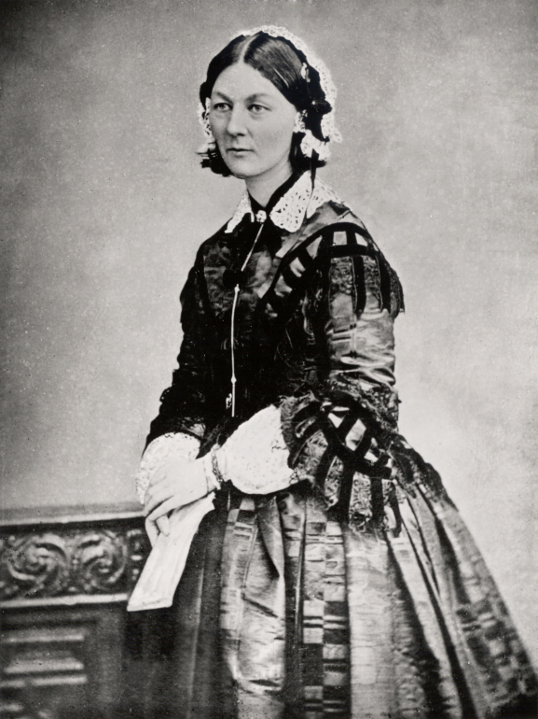
Introduction to Biostatistics
The Lady with a Lamp (1820 – 1910)
One of the early known Statistician who not only used statistical methodologies to detect the causes of deaths of British soldiers during Crimean War but also convinced Queen for evidence based policy making to provide better sanitary conditions for soldiers.
https://goo.gl/MVa1Jr

Slide 8
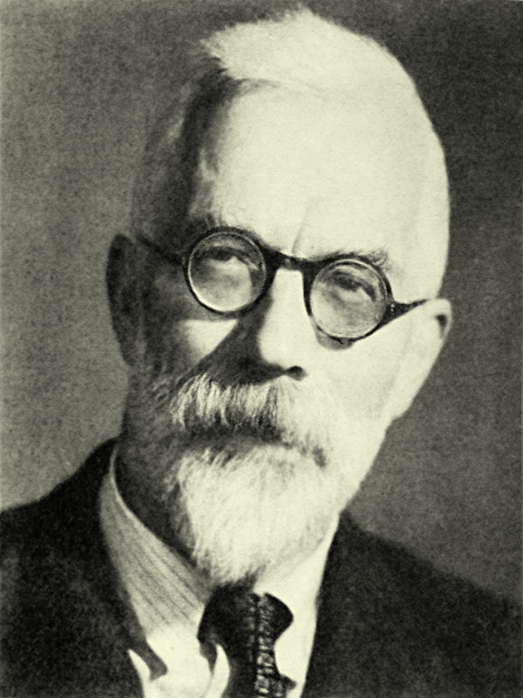
Introduction to Biostatistics
Sir Ronald A. Fisher (1890-1962)
A Bio-Statistician
Evolutionary Biologist
Geneticist
He developed Statistical Methodologies to combine Mendelian Genetics and natural selection.
Famously known as “Father of Modern Statistical sciences”.
https://goo.gl/XWdN6Z

Slide 9
Introduction to Biostatistics
Applications of Biostatistics:
Public Health
Pharmacology
Epidemiology
Medicine
Genetics
Genomics
Proteomics
Bioinformatics
etc etc

Slide 10
Introduction to Biostatistics
“To understand God’s thoughts we must study statistics, for these are the measures of HIS purpose”
Florence Nightingale(1820-1910)
END

Slide 11
Applied Biostatistics
Topic # 2

Slide 12
Basic Terminology - I
Population:
Average person thinks of a population as collection of entities usually People.
In Statistics it is Defined as “an aggregate of entities for which we have an interest at a particular time.” It can consists of Animals, machines, places or cells etc.

Slide 13
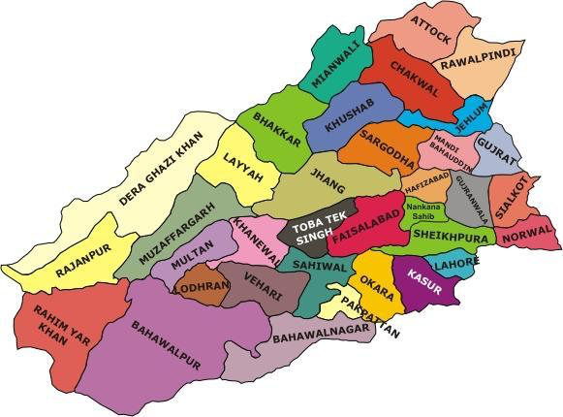
Basic Terminology - I
Example:
If we are interested in knowing the weights of all the children enrolled in elementary schools of the Bahawalpur District.
Then our population will be all the the children enrolled in elementary schools of the Bahawalpur District.
https://logofmaps.wordpress.com

Slide 14
Basic Terminology - I
Types of Population
Finite
If a population of values consists of a fixed number of these values, the population is said to be finite

Slide 15
Basic Terminology - I
Types of Population
Infinite
If a population consists of an endless succession of values, the population is infinite one.

Slide 16
Basic Terminology - I
Target Population
The General Population that the study seeks to understand.
Source Population
The specific individuals from which a representative sample will be drawn.
Sample Population
Individuals asked to participate.
Study Population
Eligible participants.
Target Population
Source Population
Sample Population
Study Population

Slide 17
Basic Terminology - I
Census
A Census is a survey conducted on a full set of observations belonging to a given population.
It is defined as “the complete enumeration of population of groups at a point in time with respect to well defined characteristics.

Slide 18
Basic Terminology - I
Population Parameter:
It is any summary number, like an average or percentage, that describes the entire population.
These are the true values, which are usually unknown.

Slide 19
Basic Terminology - I
Population Parameter:
These values are denoted by Greek letters. e.g.:
Population Mean μ (Mu)
Population Proportion π (Pi)
END

Slide 20
Applied Biostatistics
Basic Terminology - II

Slide 21
Basic Terminology - II
It is not usually possible to study the whole population.
Studying a population requires
A lot of time
resources
Sample
Population

Slide 22
Basic Terminology - II
Sample is a representative part of a Population.
A sample survey is a study that obtains data from a subset of a population of our interest, in order to estimate population attributes.
S1
S2
Population
S3
S4

Slide 23
Basic Terminology - II
Characteristics of a good sample
Representative.
It captures most of the variation in the population.
Obtained by using proper sampling methodology.

Slide 24
Basic Terminology - II
Characteristics of a good sample
Focus on objective
Informative with minimum use of resources.

Slide 25
Basic Terminology - II
Sample Statistic
Any summary number, like an average or percentage, that describes the sample.
Sample statistics are random variables.
These are the values which are usually denoted by Latin letters
Sample Standard Deviation (s)
Sample Proportion (p)
END

Slide 26
Applied Biostatistics
Topic # 4

Slide 27
Types of Statistics
Objectives of this course are twofold:
To Learn organize and summarize data.
To learn how to reach decisions about the large body of data by examining only a small part of it.

Slide 28
Types of Statistics
Types of Statistics
Descriptive Statistics
Inferential Statistics

Slide 29
Types of Statistics
Descriptive Statistics
These are the statistical methodologies which are used to Organize and Summarize data.
Together with simple graphics they form the basis for virtually every quantitative analysis of data.

Slide 30
Types of Statistics
Descriptive Statistics
Descriptive analysis is also known as Exploratory Data Analysis (EDA)

Slide 31
Types of Statistics
Inferential Statistics
These are statistical methodologies using which we reach a conclusion about a population on the basis of the information contained in the sample.
END

