Slide 1
DNA EXTRACTION METHODS
DNA Extraction is the isolation and purification of DNA (deoxyribonucleic acid)

Slide 2
DNA EXTRACTION METHODS
DNA extraction is used to isolate
Types of DNA
Mitochondrial DNA
Genomic DNA
Plasmid DNA
How Can We Recover DNA From a Variety of Sources of Biological Evidence?
Blood, Tissues, Saliva, Urine, Hair (w/Root & Shaft), Teeth, Bone, Semen, Cigarette Butts, Envelope & Stamps, Fingernail Clippings, Chewing Gum, Feces

Slide 3
Purpose of DNA Extraction
To obtain DNA in a relatively purified form which can be used for further investigations such as:
PCR (polymerase chain reaction)
RFLP (restriction fragment length polymorphism)
Southern Blotting

Slide 4
What are the essential components of a
DNA extraction Procedure?
Maximize DNA recovery
Remove inhibitors
Remove or inhibit nucleases
Maximize the quality of DNA

Slide 5
How Much DNA Can We Recover?
A Diploid Cell contains approximately 6 pg of DNA
The average WBC of an adult is 5 - 10 X 10⁶ cells per ml of blood. Therefore, the theoretical recovery of DNA per ul of blood is 30 - 60 ng
How Much DNA Do We Need?
The PCR reactions call for on average 1 ng of DNA (single or double stranded)

Slide 6
DNA Extraction protocol
Organic Method (Phenol Chloroform Isoamyl [PCI])
Inorganic Method (NaCl 6M)
Commercial available kits
CTAB (Cetyl trimethylammonium bromide): commonly used in the preparation and purification of genomic DNA from Plant

Slide 7
Material
-Lysis buffer (TE)
-Proteinase K
-Phenol-chloroform isoamyl alcohol (PCI)
-SDS 10%
-TNE buffer
-Isopropanol
- Ice cold 95-100% ethanol
- Ultrapure (DNA- & DNase-free) water

Slide 8
Lab equipment needed:
-Pippetes,
-1.5mL sterile microcentrifuge tubes or 15, 50 mL Falcons,
-Racks,
-Tips
-Vortex
- Freezer
- Centrifuge
Blood Sample
Blood collection in anticoagulant i.e. Ethylenediamide tetra-acetic acid (0.5 M EDTA) containing tube 1.5 mL eppendorf or 15 mL Falcon tube
Storage of Blood Samples
Field blood samples should be place on ice immediately after their collection store in freezer at -20°C before DNA extraction

Slide 9
Steps in Organic and Inorganic DNA Extraction
1- Lysis of Red Blood Cells, RBC
2- Digestion step (Lysis of White blood cells, WBC)
3- Phase Separation step (Extraction of Protein)
Organic DNA Extraction: PCI
Inorganic DNA Extraction: 6M NaCl
4- DNA Precipitation
5- Washing with ice cold Ethanol
6- Dilute the pellet

Slide 10
1. Lysis of Red Blood Cells, RBC
Lysis of red blood cells
Added 800 uL of Tris EDTA buffer (Tris HCl 10mM, EDTA 2mM) in 200 uL ml of the blood. Mixed by inverting several times.
Centrifuged at 5000 rpm for 10 min.
Discarded the supernatant.
Break the pellet formed at the bottom of the eppendorf tube by tapping it gently. Add 1 mL TE buffer and mixed it gently.
Centrifuged at 5000 rpm for 10 min. this step may be repeated until pallet becomes light pink.

Slide 11
2. Digestion step (Lysis of White blood cells, WBC)
Pellet obtained after lysis of RBCs re-suspended in
400 uL Buffer TNE (Tris HCL 10mM, EDTA 2mM, NaCl 400mM),
200μL 10% SDS
50 μL Proteinase K (50 μl of 10µg/uL conc.).
Homogenize the tube with gentle rotation
Samples incubate at overnight in 58 °C in shaker water bath.
Next Day

Slide 12
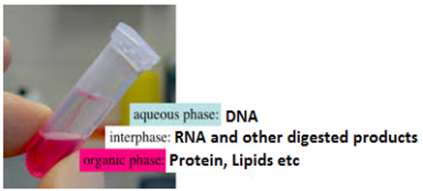
3. Phase Separation step (Extraction of Protein)
In this step, we can remove the digested protein through
6M NaCl (Inorganic Method) or
Phenol-chloroform isoamyl alcohol (PCI, in ratio 25:24:1 respectively) (Organic Method).
DNA released into solution is extracted with PCI to remove proteinaceous materials.
Add equal volume of phenol-chloroform-isoamyl (PCI) alcohol Mix gently for 2 min and centrifuge for 10 minutes at 10,000 rpm at 4C.
Carefully remove the top (aqueous) phase containing the DNA using a 1000-ul pipette transfer to a new tube.

Slide 13
4. DNA Precipitation
Precipitate the DNA with absolute isopropanol and inverted the tubes gently till DNA threads became visible and then left the tubes at room temperature for 10 minutes.
Centrifuged at 8000 rpm for 10 minutes and discarded the supernatant carefully and white pellet of DNA may visible at the bottom of the tube.

Slide 14
5. Washing with ice cold Ethanol
Washed DNA pellet with 1 mL of 70-100% ethanol, break and mix the pellet
Then centrifuged at 8000 rpm for 10 minutes and discarded the supernatant carefully
Air dried the DNA pellet at room temperature for at least 2 hours

Slide 15
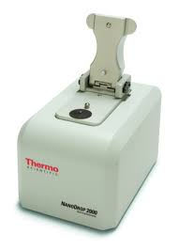
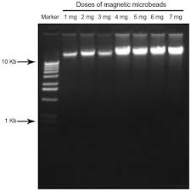
6. Dilute the pellet
Add 50-100 uL of low T.E. (Tris HCl 10 mL, EDTA 0.2mM) or DEPC water
Place the tubes in a shaking water bath at 70°C for one hour so that nucleases were inactivated. Finally DNA will store at –20ºC.
Next DNA Quantifications

