Slide 1


VUTES 7.0
Virtual University Testing & Examination System
Student Guide
Virtual University of Pakistan
http://www.vu.edu.pk

Slide 2
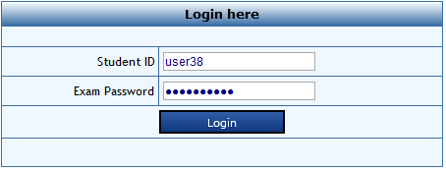
Login
Enter the student ID and exam password to log in the Exam.

Slide 3
Instructions
Before starting Exam, read the instruction carefully, related to the general examination rules, and specific to the course

Slide 4
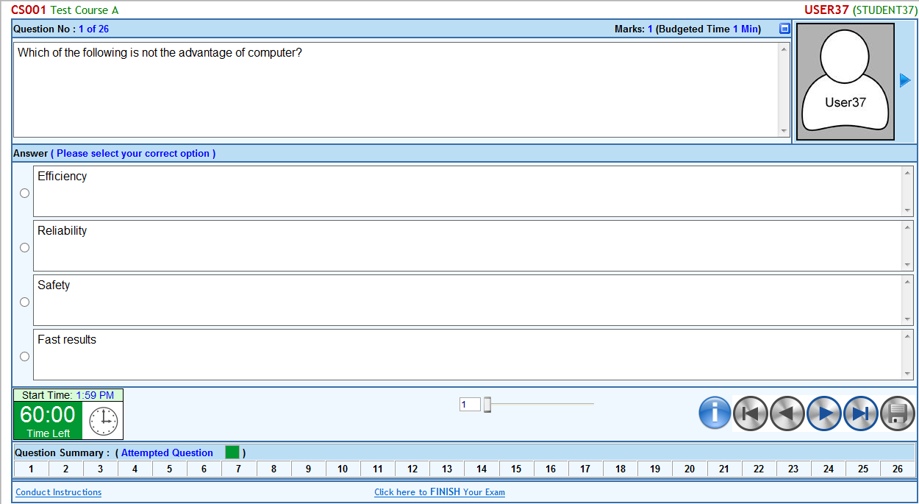
Paper
The Main Paper Screen having different section of Information, Question, Answer and functionalities

Slide 5
Paper Top Section
This TOP section of Paper Screen
  Course Description including Course Code and Title
  Student ID & Student Name
  Current Question No. vs Total No. of Questions
  Question Marks and Budged Time
1
2
3
4

Slide 6
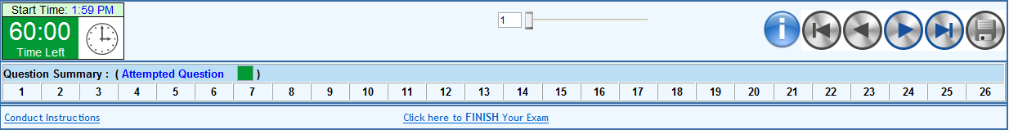
Paper Bottom Section
This BOTTOM section of the paper
  Timer having Start Time and Time Left
  Instruction Button
  Question Navigation buttons
  Question Save button
  Attempted / Un-attempted Questions
  Conduct Instruction
  Finish Bottom
1
2
3
4
5
6
7

Slide 7
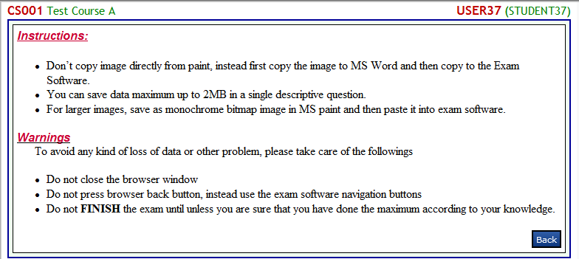
Instruction
The instruction icon available in the bottom of the paper will allow the student to open and read the Exam related instruction

Slide 8
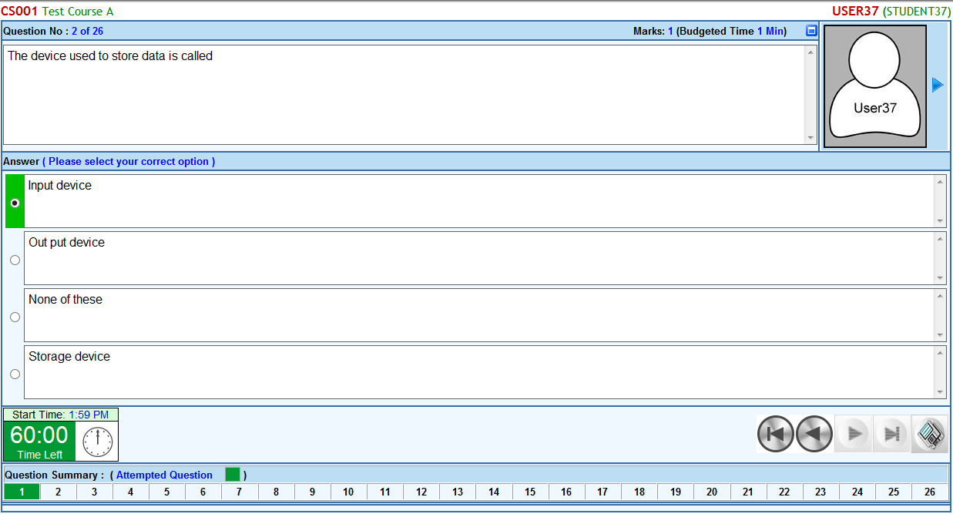
Multiple Choice Question
Multiple choice questions
  Select the correct
  Save the selected option
1
2

Slide 9
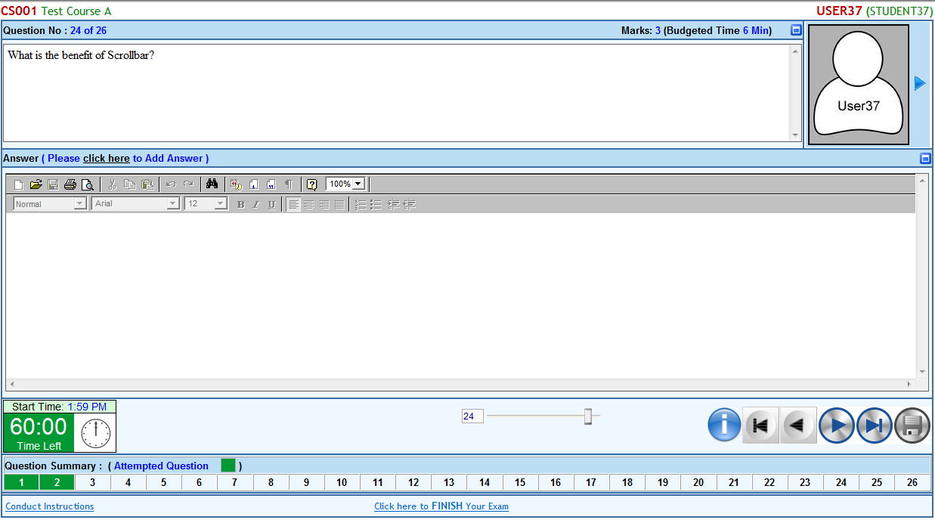
Descriptive Question
Descriptive question
  Click here to enable the text editor of answer panel to write the answer
  Standard Toolbar of the text editor
  Text Formatting toolbar of the text editor
1
2
3

Slide 10
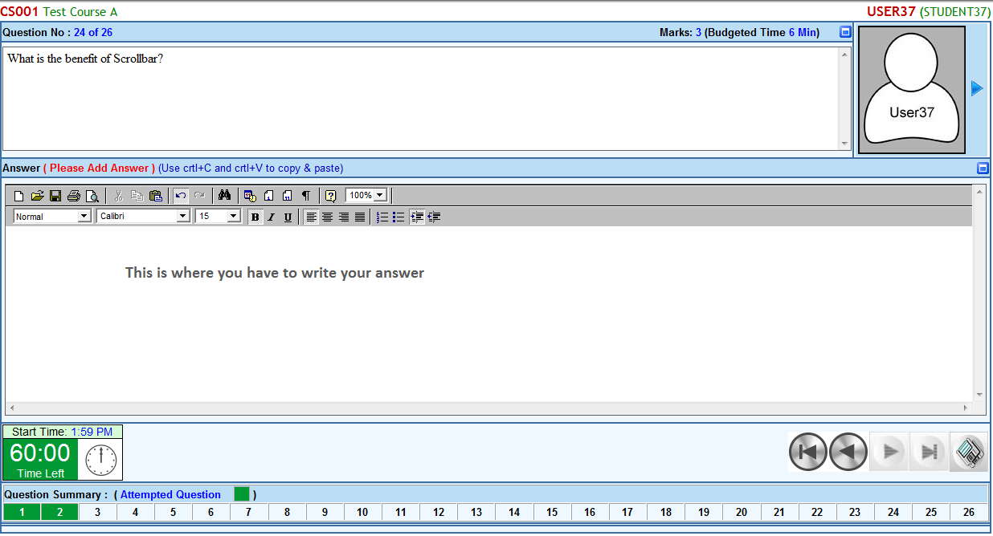
Descriptive Question cont.…
Descriptive Question Saving
  Write the answer in this answer panel (Use Crtl+C and Crtl+V to copy & past from other software)
  Press Save button
1
2

Slide 11

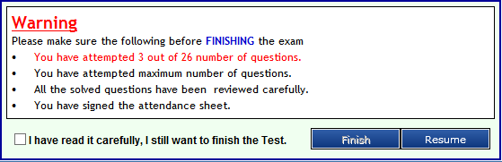
Finish Paper
Paper finish screen:
  Click on the Finish icon of the bottom section of the paper
  Information panel display the No. of questions attempted
  Click RESUME button if you want to continue the paper
1
2
3

Slide 12
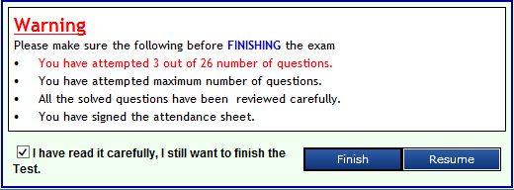
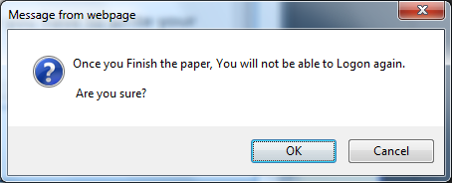
Finish Paper (Warning & Alert panel)
Submit the paper after reading all the warnings and dually confirmed.
  Click the checkbox to enable the Finish button
  Click FINISH button to finish Exam
  Click OK button to dually confirm the Finish exam
1
2
3

Slide 13
Exam Feedback
Fill the feedback (if available) form related to the exam and submit.

Slide 14
Thank You

